Slide 1
DEEP FAKE
Generation
ABHIJITH T S
C0PSCS2102
Guided by Mrs. LISHA A

Slide 2
CONTENTS
Introduction
Abstract
Literature Survey
Proposed System
Conclusion
References

Slide 3
1.INTRODUCTION
Generating videos by animating objects in still images has countless applications across areas of interest including movie production, photography, and e-commerce.
More precisely, image animation refers to the task of automatically synthesizing videos by combining the appearance extracted from a source image with motion patterns derived from a driving video.
In particular, Generative Adversarial Networks (GANs) and Variational Auto-Encoders (VAEs) have been used to transfer facial expressions or motion patterns between human subjects in videos.

Slide 4
2. ABSTRACT
A generator network models occlusions arising during target motions and combines the appearance extracted from the source image and the motion derived from the driving video.
Once trained on a set of videos depicting objects of the same category (e.g. faces, human bodies), our method can be applied to any object of this class.

Slide 5
3. LITERATURE SURVEY
Old model
Monkey-Net, the first object-agnostic deep model for image animation. It encodes motion information via key points learned in a self-supervised fashion.
At test time, the source image is animated according to the corresponding key point trajectories estimated in the driving video.
The major weakness of Monkey-Net is that it poorly models object appearance transformations in the key point neighborhoods assuming a zeroth order model

Slide 6
Advantage of proposed system
The proposed system uses a set of self-learned key points together with local affine transformations to model complex motions. Thus the method is known as a first-order motion model.
Second, we introduce an occlusion-aware generator, which adopts an occlusion mask automatically estimated to indicate object parts that are not visible in the source image and that should be inferred from the context. This is especially needed when the driving video contains large motion patterns and occlusions are typical.
Third, we extend the equivariance loss commonly used for key points detector training, to improve the estimation of local affine transformations.

Slide 7
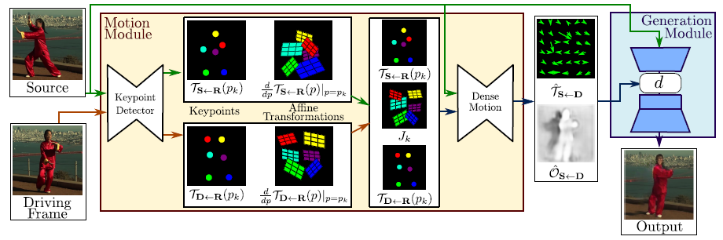
4. PROPOSED SYSTEM

Slide 8
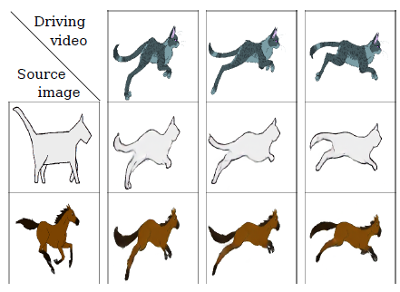

Slide 9
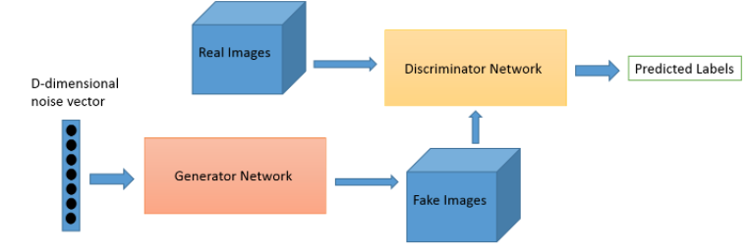
Generative Adversarial Networks
Generative adversarial networks (GANs)
are algorithmic architectures that use two neural networks, pitting one against the other (thus the “adversarial”) in order to generate new, synthetic instances of data that can pass for real data. They are used widely in image generation, video generation and voice generation.

Slide 10
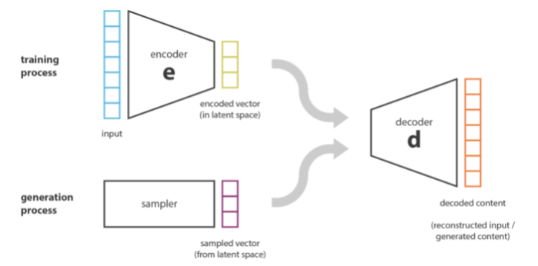
Variational Auto-Encoders
variational autoencoder
can be defined as being an autoencoder whose training is regularized to avoid overfitting and
ensure that the latent space has good properties that enable generative process.
The latent space is simply a representation of compressed data in which similar data points are
closer together in space.

Slide 11
Overview of the approach
The method assumes a source image S and a frame of a driving video frame D as inputs.
The unsupervised key point detector extracts first order motion representation consisting
of sparse key points and local affine transformations with respect to the reference frame R.
The dense motion network uses the motion representation to generate dense optical
flow from D to S and occlusion map
The source image and the outputs of the dense motion network are used by the generator
to render the target image.

Slide 12
6. CONCLUSION
We presented a novel approach for image animation based on key points and local affine transformations.
This novel mathematical formulation describes the motion field between two frames and is efficiently computed by deriving a first order Taylor expansion approximation.
In this way, motion is described as a set of key points displacements and local affine transformations.
A generator network combines the appearance of the source image and the motion representation of the driving video.

Slide 13
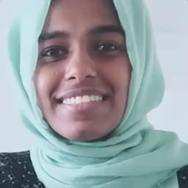
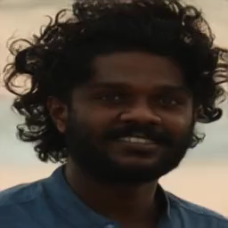

Slide 14
7. REFERENCES
First Order Motion Model for Image Animation by Aliaksandr Siarohin, Stéphane Lathuilière, Sergey Tulyakov, Elisa Ricci, and Nicu Sebe
Repository : https://github.com/AliaksandrSiarohin/first-order-model

